Slide 1
3D racing web game
By Tamer Hussen

Slide 2
Task
To create and present a 3D web game and website using HTML, CSS and JS.

Slide 3
Game Type and description
Type: racing simulator game
Description: Players will race and avoid obstacles to gain a high score.

Slide 4
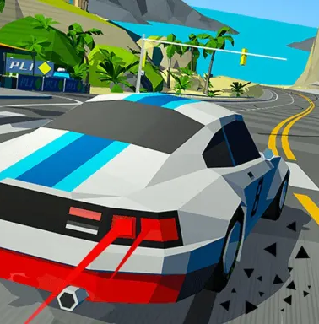
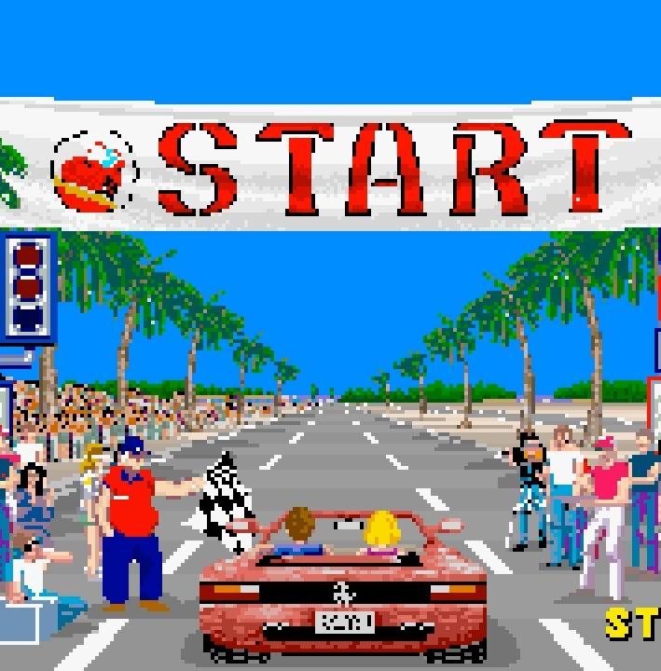
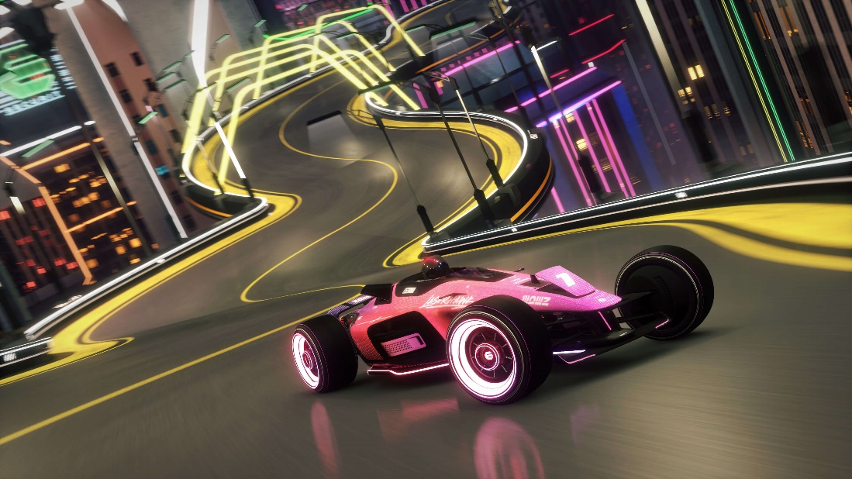
Image examples
Image 1 - style
Image 2 - gameplay
Image 3 - FOV

Slide 5
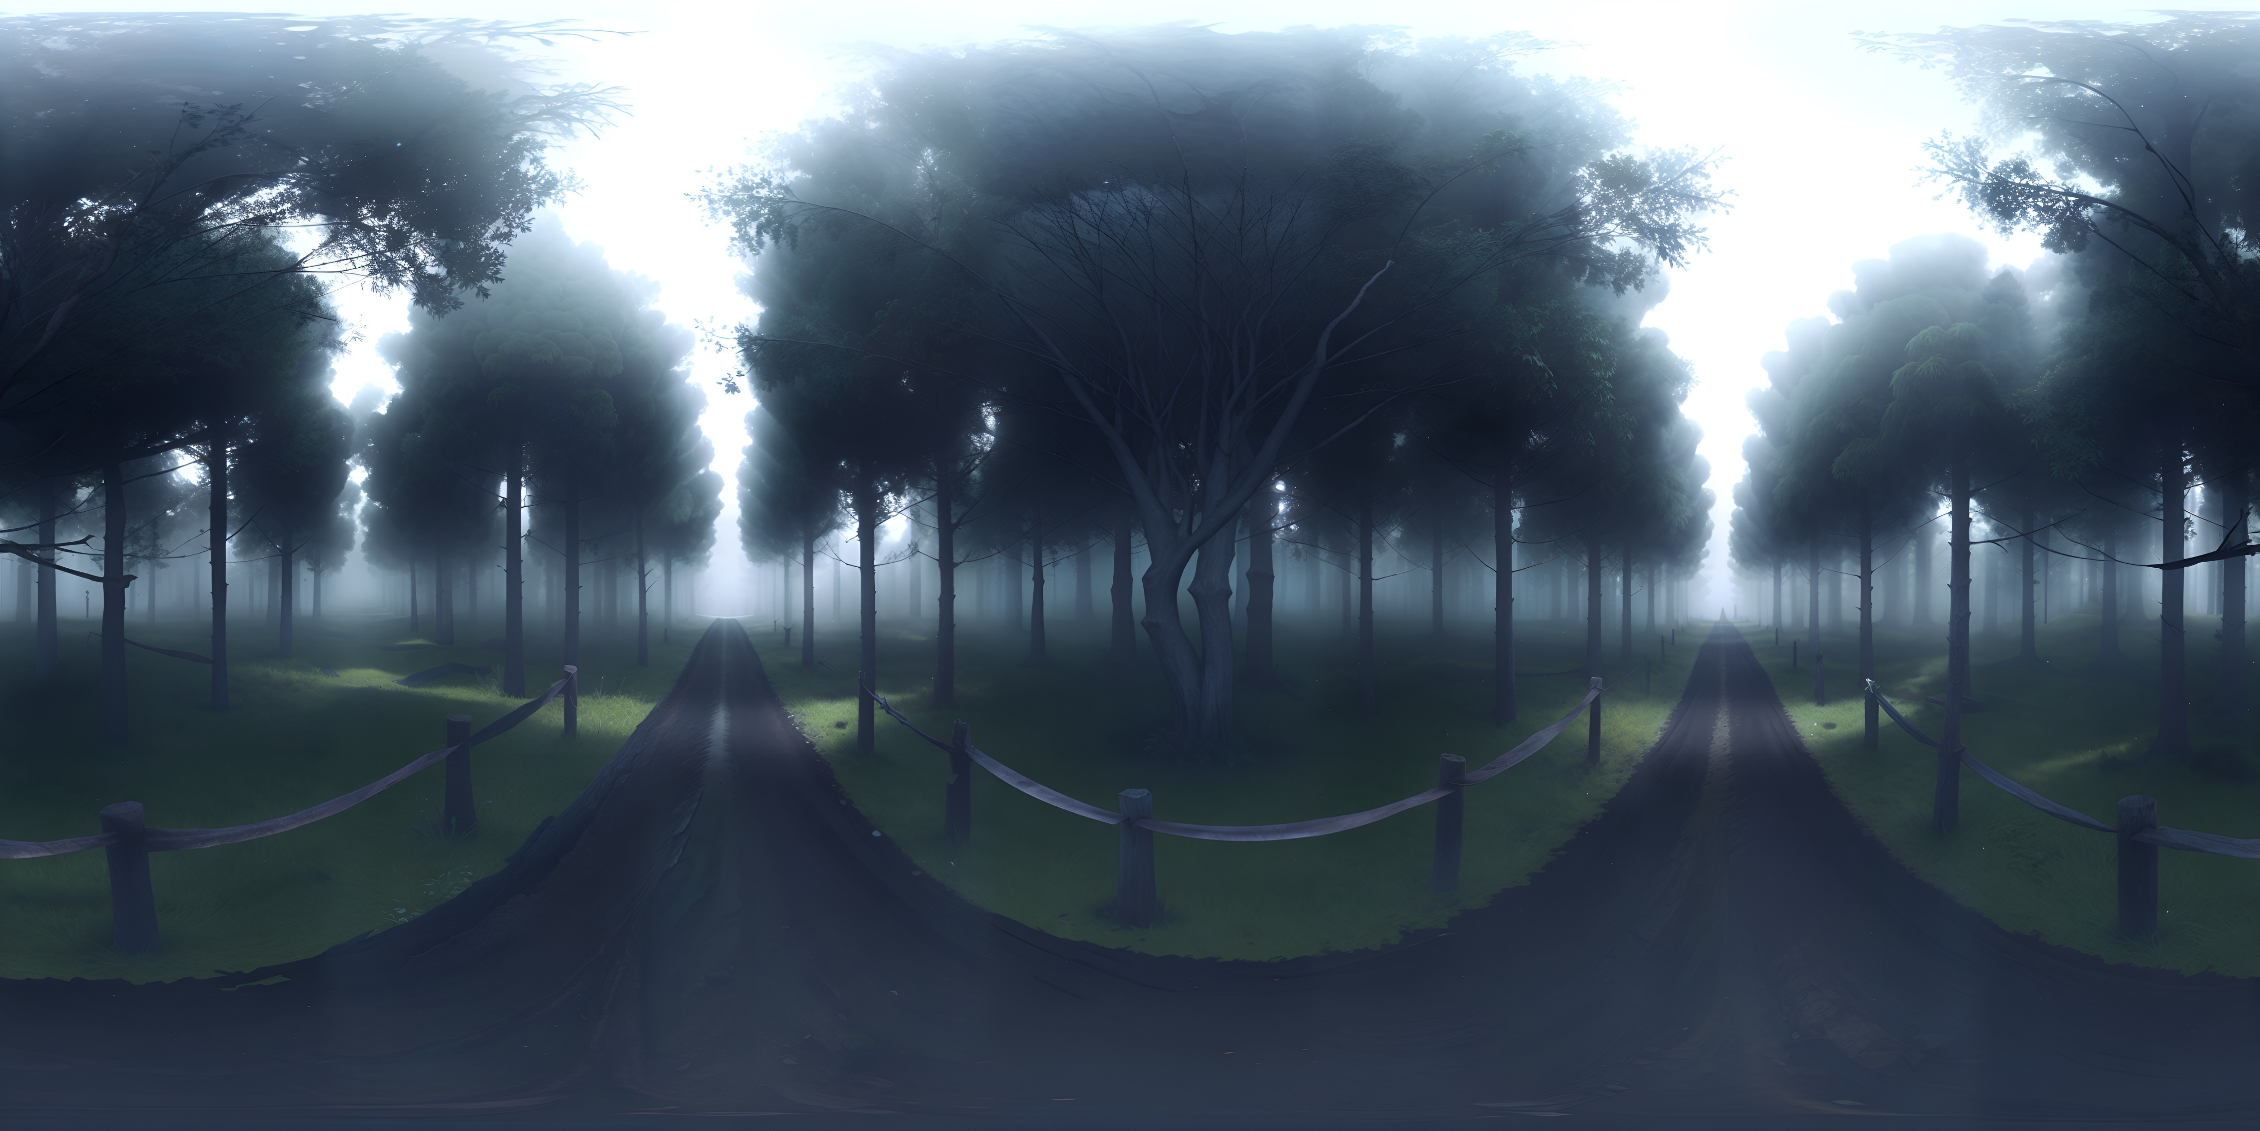
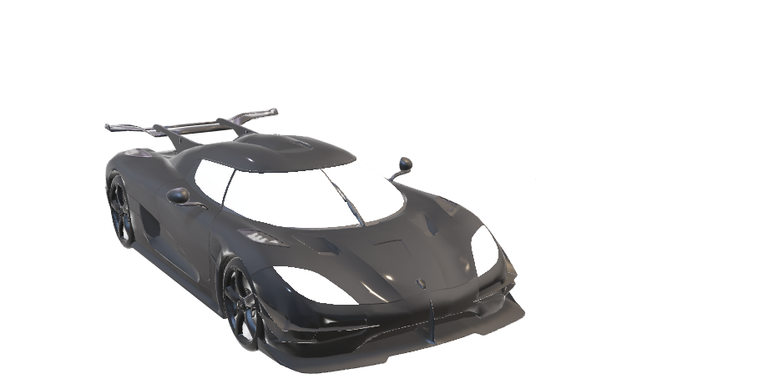
assets
Player character - car
Sky box - Forest

Slide 6
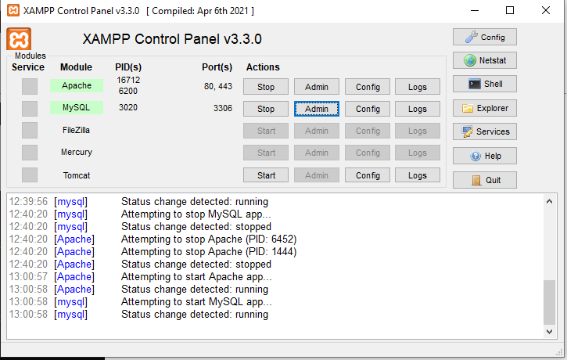
Server Set up
Install Portable Software
Download Node.js Portable and XAMPP Portable.
Extract them into a folder of your choice.
Set Up Node Project
Open a terminal in your project folder.
Run: npm init –y.
Create a server.js file in your visual studio code.
Start MySQL Database
Open XAMPP, start MySQL
Create a database for your project using phpMyAdmin.
Install Packages
Run: npm install express mysql.
Start the Server
Run: node server.js.
Open http://localhost:3000 in your browser to view your project.
Image example of XAMPP to start server

Slide 7
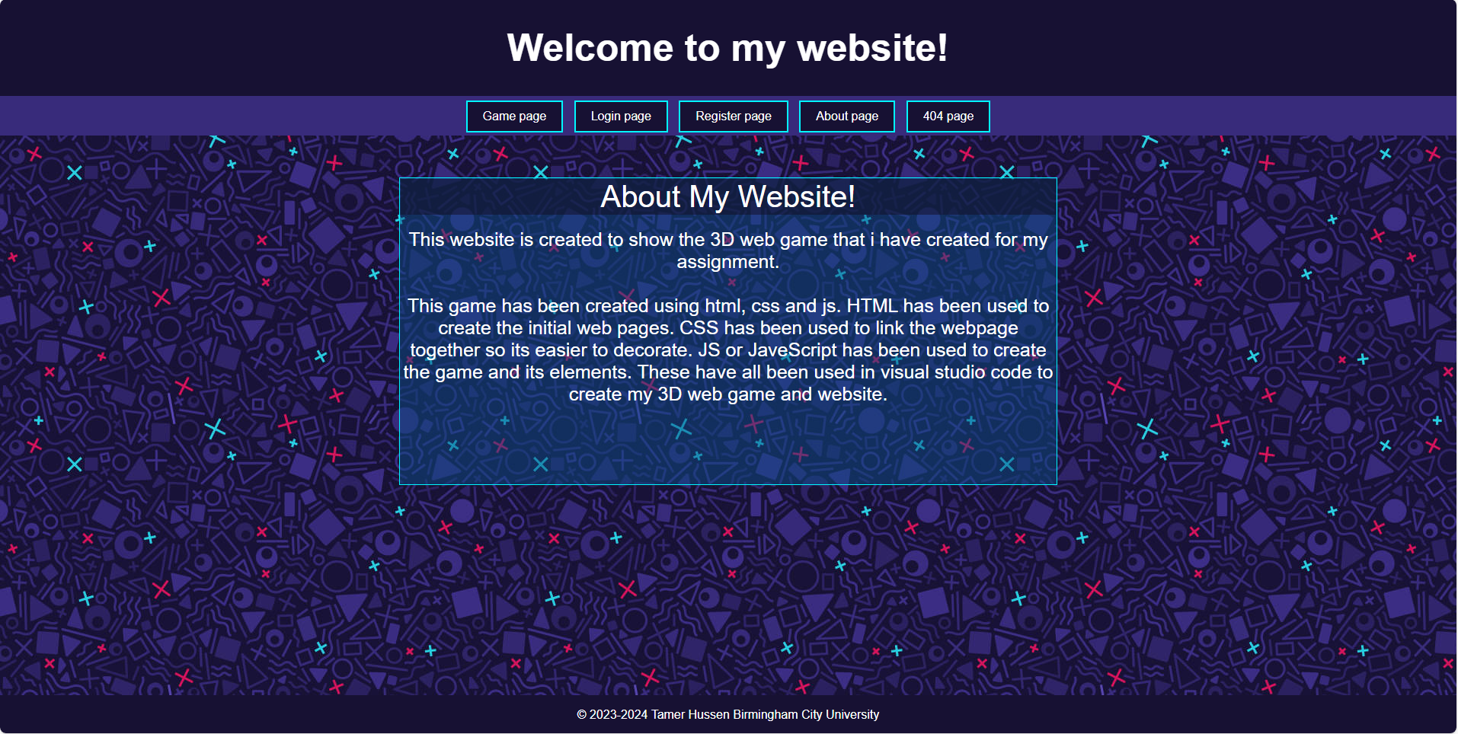
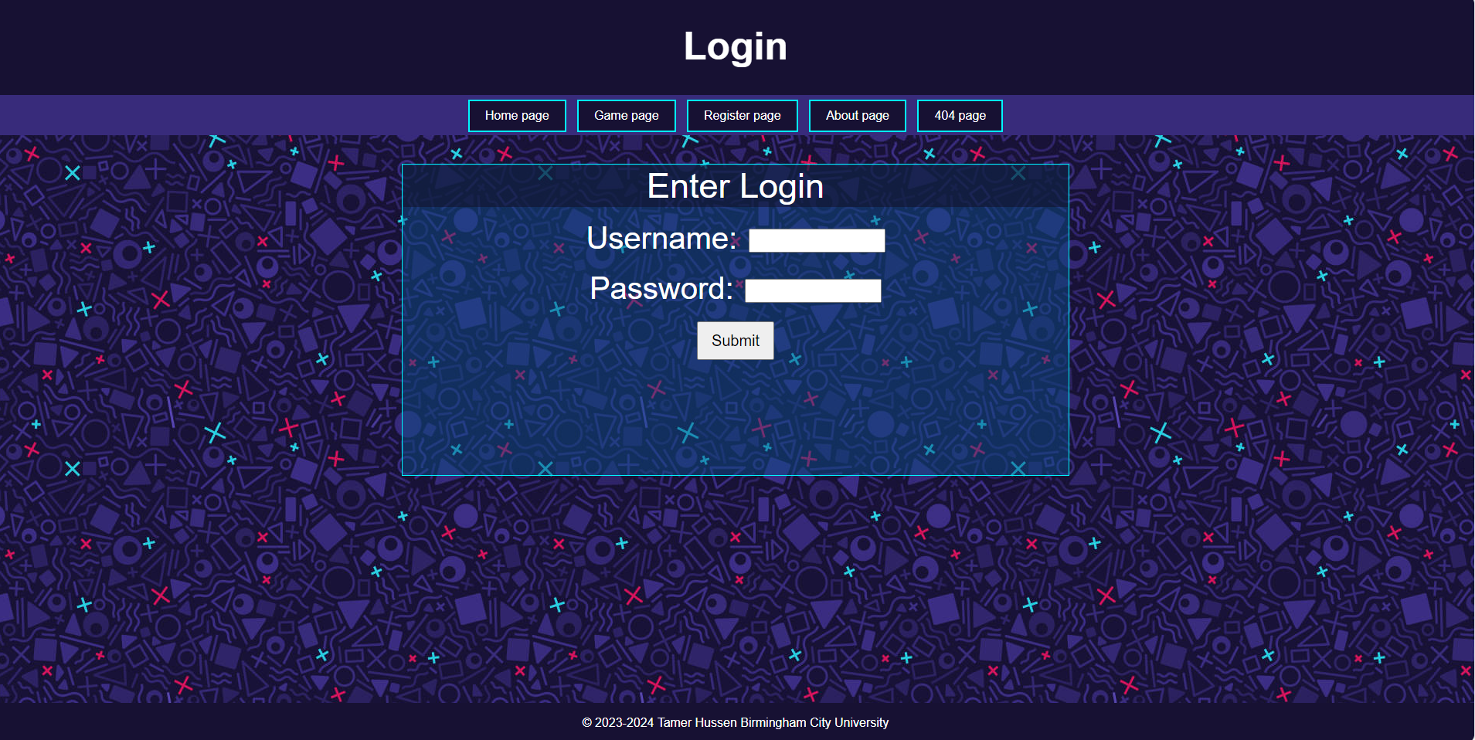

Website preview
Image 1 – home page of website
Image 2 – login page of website
Image 3 – 404 page of website

Slide 8
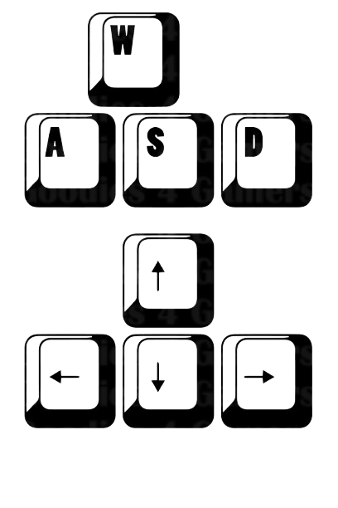
Game Controls
A
A
C
B
D
C
A
D
Controls – [A] Forward, [B] slow down / stop , [C] Left, [D] right

Slide 9
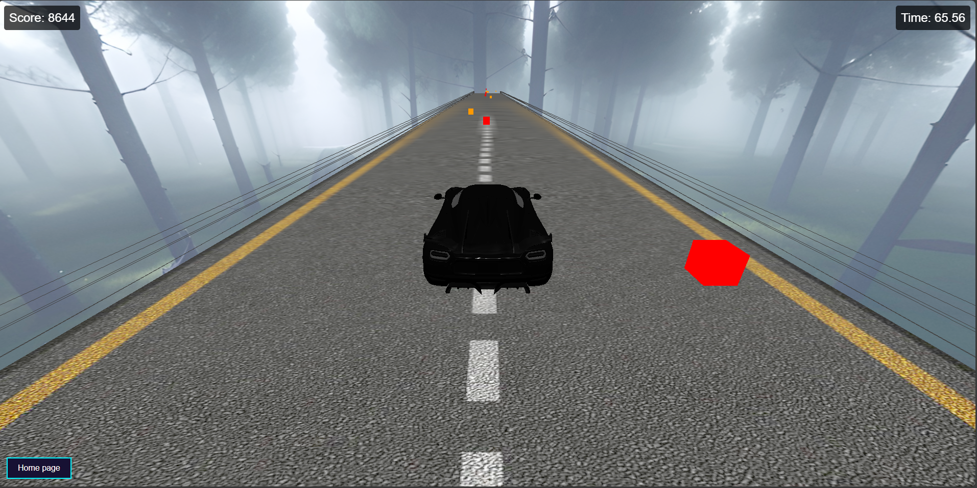
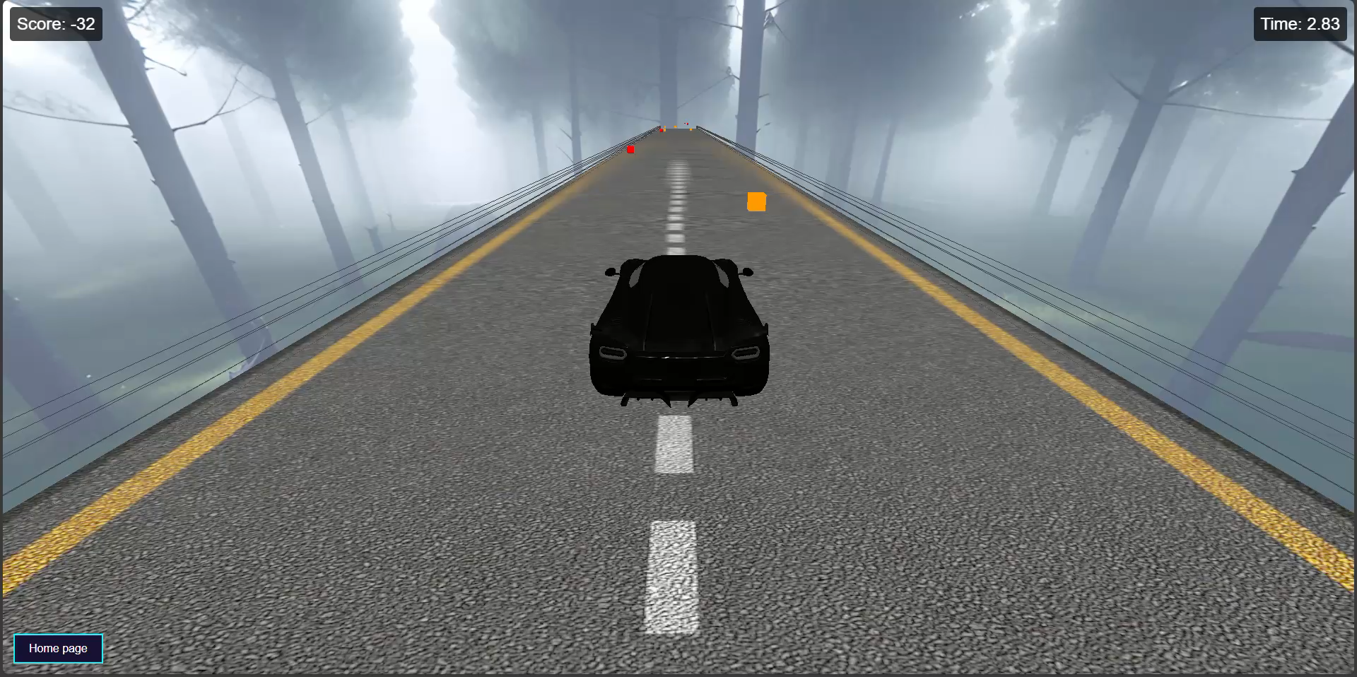
Game preview
A
A
A
C
B
C
D
Image 1 – [A] game UI, [B] player character, [C] obstacles, [D] home button
video 1 – preview of game

Slide 10
references
3D Models for Free - Free3D.com
- 3D models
Sketchfab
- Skybox
Three.js – JavaScript 3D Library
- JavaScript codes
https://youtu.be/faHxj0RYLZE
- Code assist
W3Schools Online Web Tutorials
- Website examples

Slide 11
Any questions?

